Slide 1
Zen of Data
Lesson 1.1

Slide 2

Notes:
shutterstock_1023343447

Slide 3
Quick Introductions! (30 seconds)
Name
Where From?
Background (Career, Education, Interests)
Why are you here?
Fears about class?

Slide 4
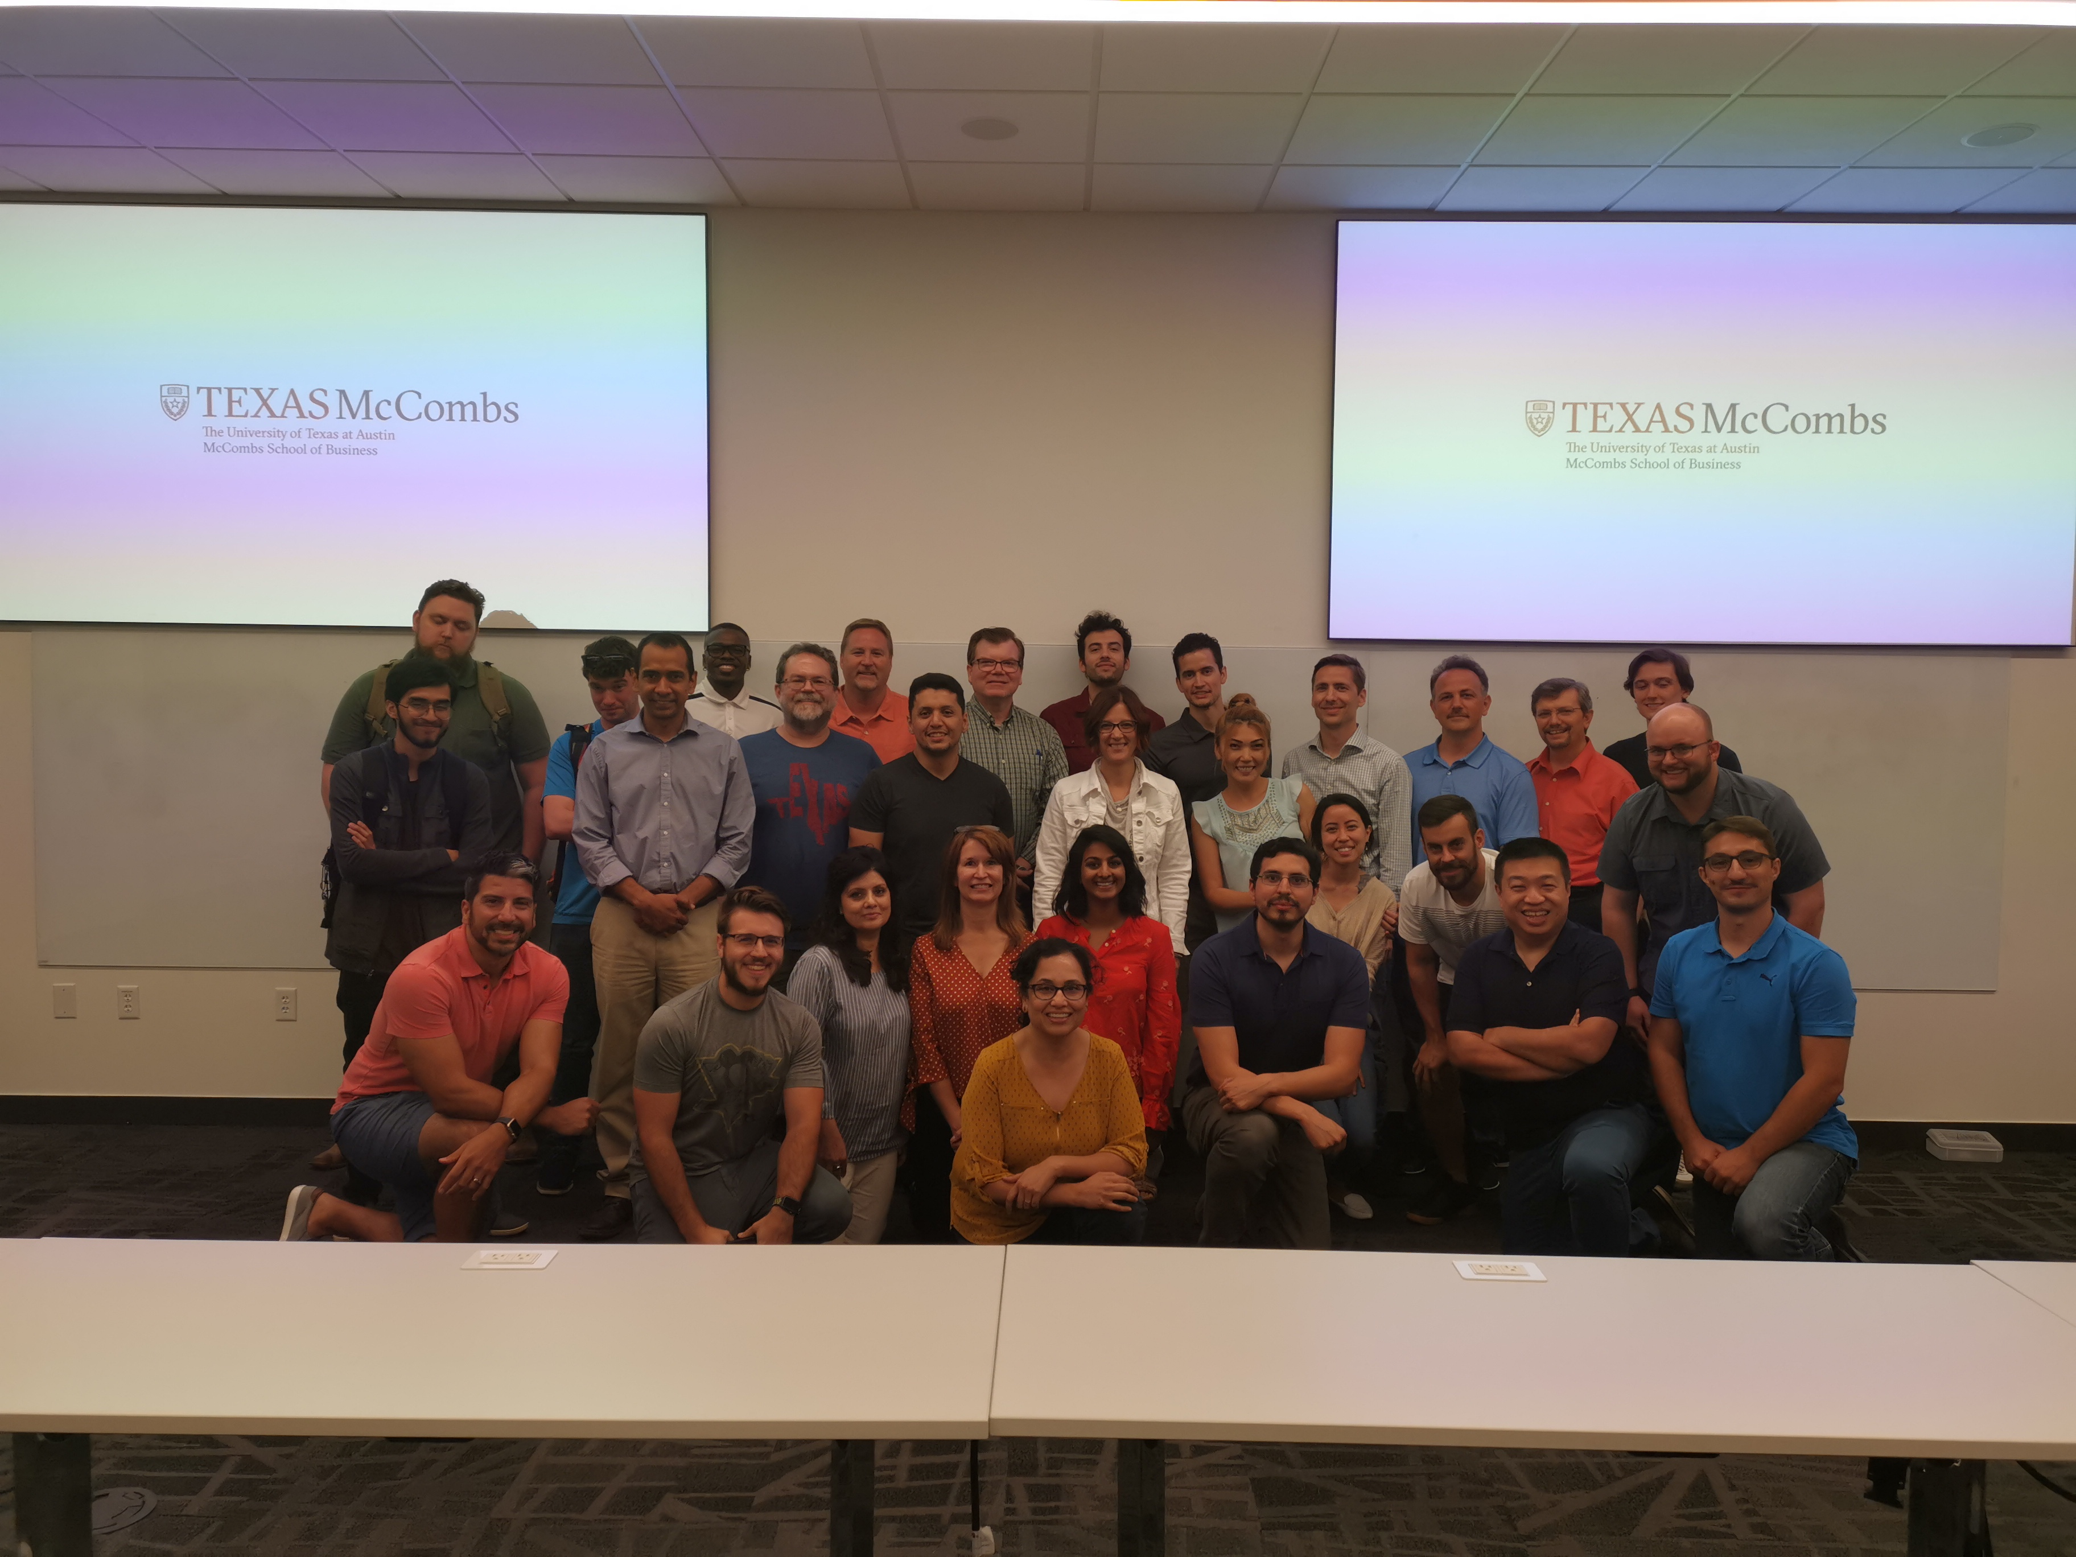
Instructor = … ?
Manuel Lara
Data Scientist at Lessons.com
High Energy Physics Experiments
Over 8 years data wrangling (with plenty of experience being a n00b at it.)
LOVES teaching
Sharing knowledge
Traveling/Adventures
YOUR PHOTO
GOES HERE

Slide 5

Things I’ve Worked On…
Cool Data Project You’ve Worked on Goes Here

Slide 6


Things I’ve Worked On…
Cool Data Project You’ve Worked on Goes Here

Slide 7


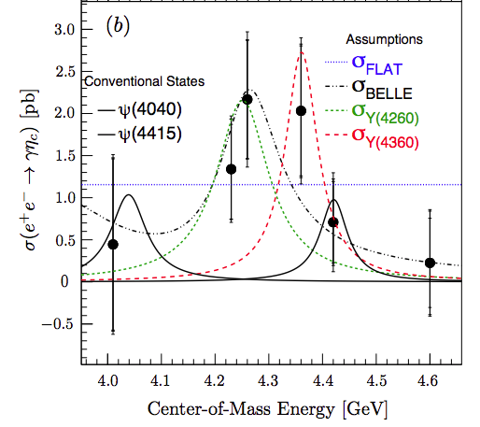
Things I’ve Worked On…
Cool Data Project You’ve Worked on Goes Here

Slide 8
The Rise of Data

Slide 9
Why is data analytics such a hot skill these days?

Slide 10

Explosive Growth in Digitized Data (Creation)
1
Notes:
shutterstock_196005458

Slide 11

Explosive Growth in Analytic Tools (Synthesis)
2
Notes:
shutterstock_746652745

Slide 12
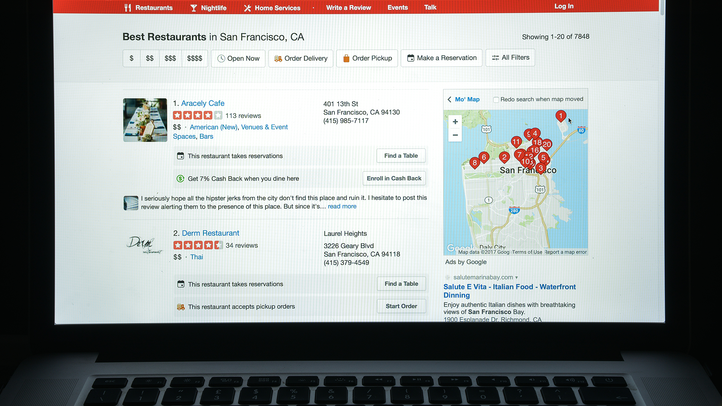
Accelerating Search for Actionable Insight (Value)
3
Notes:
shutterstock_703232770

Slide 13

What does the term data mean?
Notes:
shutterstock_91508951

Slide 14

Perhaps you are picturing an Excel spreadsheet.
Notes:
shutterstock_787784326

Slide 15

Data Science Involves Spreadsheets and Formulas
Notes:
shutterstock_279072509

Slide 16
Fundamentally, data science is about storytelling and truth-telling.

Slide 17
Data as Truth-Telling

Slide 18
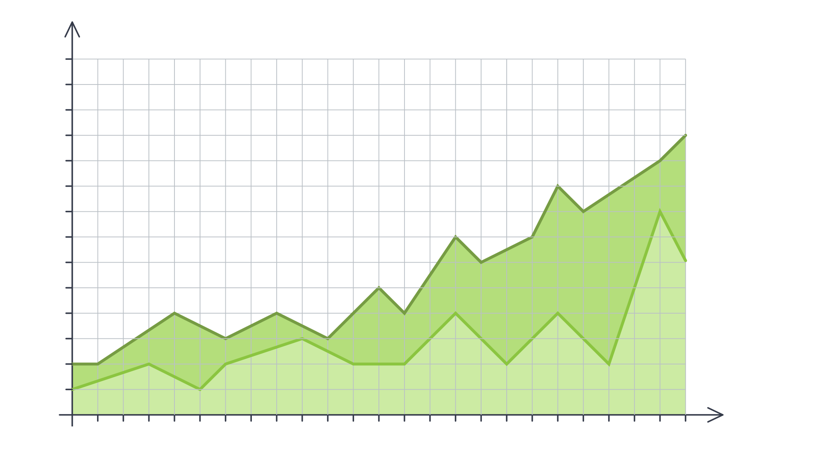


Data as Truth-Telling
Unearthing Relationships
Lung Cancer Deaths per 100,000
100k
95k
80k
85k
80k
75k
70k
65k
60k
55k
50k
45k
40k
35k
30k
25k
20k
1900
1901
1902
1903
1904
1905
1906
1907
1908
1909
1909
1910
1911
1912
1913
1914
1915
1916
1917
1918
1919
1920
Lung Cancer Deaths
Cigarettes Smoked
Notes:
Image was recreated.

Slide 19

Data as Truth-Telling
Making Predictions
Notes:
shutterstock_1049641082

Slide 20
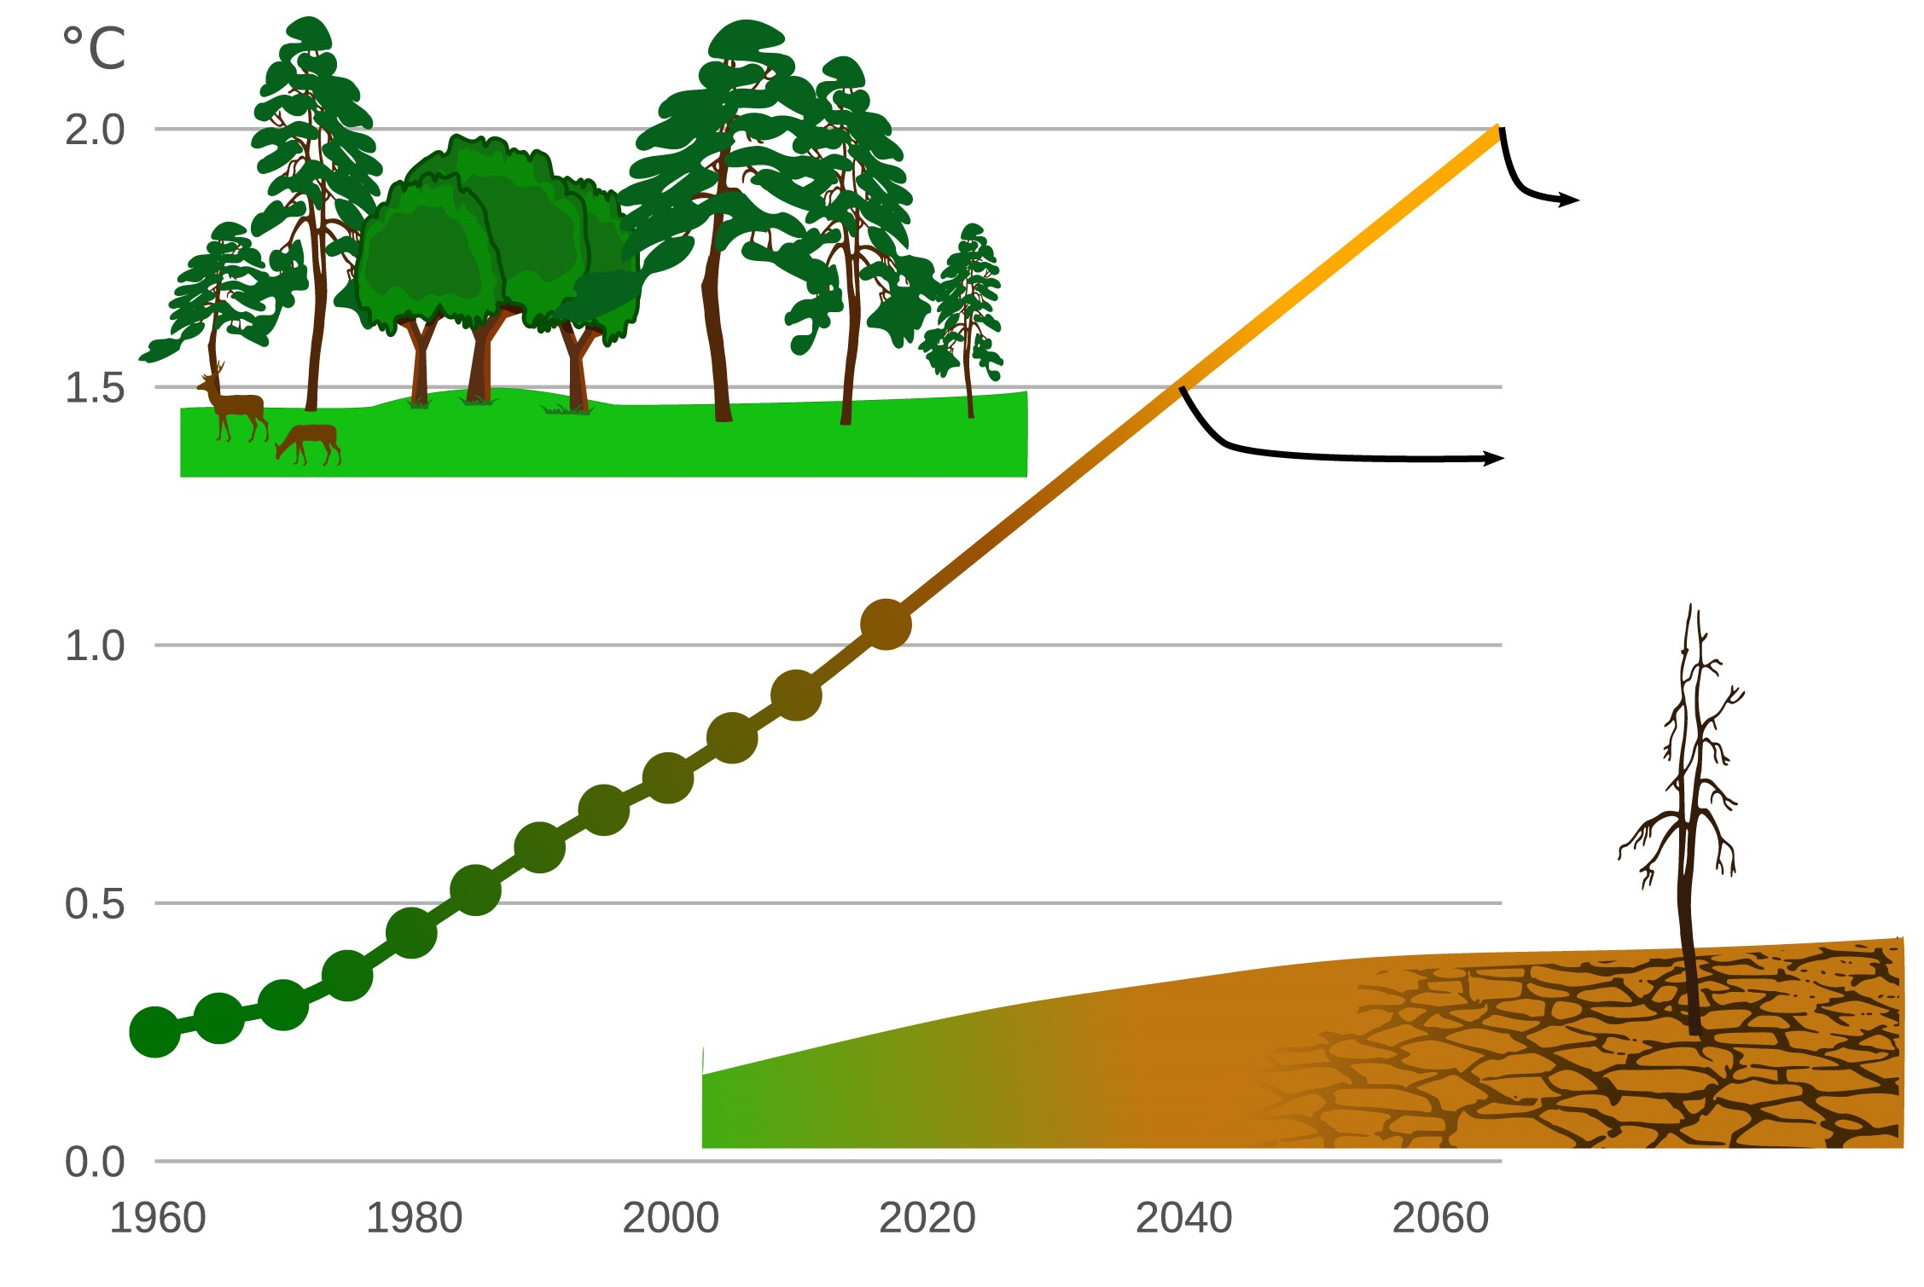
Data as Truth-Telling
Stating Significance
Exposure to Extreme Drought Is Increasing
190 million people
114 million people
Notes:
shutterstock_1308705436

Slide 21
Data as Storytelling

Slide 22
Data as Storytelling
U.S. Debt as Percentage of Gross Domestic Product, 1790–2011
1790 | 29,6% | 1835 | 0.0 | 1880 | 18.4 | 1925 | 21.6 |  | 1970 | 28.0
1791 | 29.2 | 1836 | 0,0 | 1881 | 16.8 | 1926 | 19.0 |  | 1971 | 28.1
1792 | 28.0 | 1837 | 0.2 | 1882 | 14.3 | 1927 | 18.0 |  | 1972 | 27.4
1793 | 24.4 | 1838 | 0.6 | 1883 | 13.5 | 1928 | 17.0 |  | 1973 | 26.0
1794 | 21.8 | 1839 | 0.2 | 1884 | 13.3 | 1929 | 14.9 |  | 1974 | 23.9
1795 | 18.7 | 1840 | 0.3 | 1885 | 13.2 | 1930 | 16.5 |  | 1975 | 25.3
1796 | 16.4 | 1841 | 0.8 | 1886 | 12.4 | 1931 | 22.3 |  | 1976 | 27.5
1797 | 16.5 | 1842 | 1.2 | 1887 | 11.2 | 1932 | 34.5 |  | 1977 | 27.8
1798 | 16.0 | 1843 | 1.5 | 1888 | 10.2 | 1933 | 39.1 |  | 1978 | 27.4
1799 | 15.8 | 1844 | 1.0 | 1889 | 8.6 | 1934 | 44.0 |  | 1979 | 25.6
1800 | 15.1 | 1845 | 0.7 | 1890 | 7.8 | 1935 | 42.9 |  | 1980 | 26.1
1801 | 13.3 | 1846 | 1.2 | 1891 | 7.0 | 1936 | 43.0 |  | 1981 | 25.8
1802 | 13.9 | 1847 | 1.7 | 1892 | 6.6 | 1937 | 40.1 |  | 1982 | 28.7
1803 | 14.1 | 1848 | 2.2 | 1893 | 6.8 | 1938 | 42.8 |  | 1983 | 33.1
1804 | 13.2 | 1849 | 2.5 | 1894 | 7.9 | 1939 | 43.0 |  | 1984 | 34.0
1805 | 10.9 | 1850 | 2.3 | 1895 | 7.9 | 1940 | 42.7 |  | 1985 | 26.4
1806 | 10.0 | 1851 | 2.4 | 1896 | 8.5 | 1941 | 43.3 |  | 1986 | 38.5
The Great Depression & World War II
Reagan Tax Cuts
Data: Congressional Budget Office
Notes:
Image was recreated

Slide 23
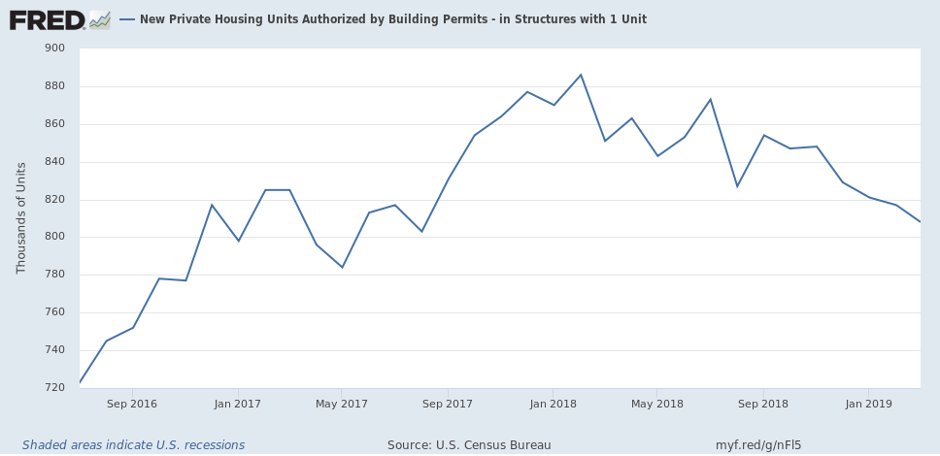
Data = Drama
New Housing Construction: Making A Bottom, At Close To Recessionary Levels
https://seekingalpha.com
Notes:
Screenshot from: https://seekingalpha.com/article/4255461-march-new-housing-construction-making-bottom-close-recessionary-levels

Slide 24
Course Overview

Slide 25



Tools for Truths, Skills for Stories:
Our Goals:
Our Means:
Microsoft Excel
Python
pandas
Matplotlib/Seaborn
APIs
Beautiful Soup
Machine Learning
SQL
MongoDB
HTML/CSS
JavaScript
D3.js
Leaflet.js/Google Maps
Tableau
Hadoop
Truth-telling
Storytelling

Slide 26
Course Overview
Each class will include the following:
Overview of Lesson Topics
Instructor Lecture
Instructor Demonstration
Class Discussions
In-Class Activities
Project Work

Slide 27
Weekly Breakdown by Subject

Slide 28
Weeks 1–2
Intro to Data Analytics & Excel Masters: Introduction to the high-level concepts of data analytics and real-world data crunching with Excel formulas, pivot tables, and conditional formatting.
Week 1
Week 2
Week 3
Week 4
Week 5
Week 6
Week 7
Week 8
Week 9
Week 10
Week 11
Week 12
Week 13
Week 14
Week 15
Week 16
Week 17
Week 18
Week 19
Week 20
Week 21
Week 22
Week 23
Week 24
Python Data Analytics and Visualization: Thorough crash course on Python programming, followed by multiple weeks of data processing using advanced libraries like NumPy, pandas, Matplotlib, Seaborn, and Beautiful Soup.
Deep Dive into Databases: Immersion into introductory and advanced work with SQL (PostgreSQL) and noSQL databases (MongoDB).
Web-Based Data Visualization: Introduction to the fundamental tools of web development (HTML, CSS, JavaScript) and advanced libraries that are useful for data visualization (D3.js, Leaflet.js).
Final Projects & Advanced Topics: Introduction to Tableau and R as well as advanced topics like Hadoop and Machine Learning. Develop a real-world data visualization project.

Slide 29
Weeks 3–9
Week 1
Week 2
Week 3
Week 4
Week 5
Week 6
Week 7
Week 8
Week 9
Week 10
Week 11
Week 12
Week 13
Week 14
Week 15
Week 16
Week 17
Week 18
Week 19
Week 20
Week 21
Week 22
Week 23
Week 24
Intro to Data Analytics & Excel Masters: Introduction to the high-level concepts of data analytics and real-world data crunching with Excel formulas, pivot tables, and conditional formatting.
Python Data Analytics and Visualization: Thorough crash course on Python programming, followed by multiple weeks of data processing using advanced libraries like NumPy, pandas, Matplotlib, Seaborn, and Beautiful Soup.
Deep Dive into Databases: Immersion into introductory and advanced work with SQL (PostgreSQL) and noSQL databases (MongoDB).
Web-Based Data Visualization: Introduction to the fundamental tools of web development (HTML, CSS, JavaScript) and advanced libraries that are useful for data visualization (D3.js, Leaflet.js).
Final Projects & Advanced Topics: Introduction to Tableau and R as well as advanced topics like Hadoop and Machine Learning. Develop a real-world data visualization project.

Slide 30
Weeks 10–12
Week 1
Week 2
Week 3
Week 4
Week 5
Week 6
Week 7
Week 8
Week 9
Week 10
Week 11
Week 12
Week 13
Week 14
Week 15
Week 16
Week 17
Week 18
Week 19
Week 20
Week 21
Week 22
Week 23
Week 24
Intro to Data Analytics & Excel Masters: Introduction to the high-level concepts of data analytics and real-world data crunching with Excel formulas, pivot tables, and conditional formatting.
Python Data Analytics and Visualization: Thorough crash course on Python programming, followed by multiple weeks of data processing using advanced libraries like NumPy, pandas, Matplotlib, Seaborn, and Beautiful Soup.
Deep Dive into Databases: Immersion into introductory and advanced work with SQL (PostgreSQL) and noSQL databases (MongoDB).
Web-Based Data Visualization: Introduction to the fundamental tools of web development (HTML, CSS, JavaScript) and advanced libraries that are useful for data visualization (D3.js, Leaflet.js).
Final Projects & Advanced Topics: Introduction to Tableau and R as well as advanced topics like Hadoop and Machine Learning. Develop a real-world data visualization project.

Slide 31
Weeks 13–17
Week 1
Week 2
Week 3
Week 4
Week 5
Week 6
Week 7
Week 8
Week 9
Week 10
Week 11
Week 12
Week 13
Week 14
Week 15
Week 16
Week 17
Week 18
Week 19
Week 20
Week 21
Week 22
Week 23
Week 24
Intro to Data Analytics & Excel Masters: Introduction to the high-level concepts of data analytics and real-world data crunching with Excel formulas, pivot tables, and conditional formatting.
Python Data Analytics and Visualization: Thorough crash course on Python programming, followed by multiple weeks of data processing using advanced libraries like NumPy, pandas, Matplotlib, Seaborn, and Beautiful Soup.
Deep Dive into Databases: Immersion into introductory and advanced work with SQL (PostgreSQL) and noSQL databases (MongoDB).
Web-Based Data Visualization: Introduction to the fundamental tools of web development (HTML, CSS, JavaScript) and advanced libraries that are useful for data visualization (D3.js, Leaflet.js).
Final Projects & Advanced Topics: Introduction to Tableau and R as well as advanced topics like Hadoop and Machine Learning. Develop a real-world data visualization project.

Slide 32
Weeks 18–24
Week 1
Week 2
Week 3
Week 4
Week 5
Week 6
Week 7
Week 8
Week 9
Week 10
Week 11
Week 12
Week 13
Week 14
Week 15
Week 16
Week 17
Week 18
Week 19
Week 20
Week 21
Week 22
Week 23
Week 24
Intro to Data Analytics & Excel Masters: Introduction to the high-level concepts of data analytics and real-world data crunching with Excel formulas, pivot tables, and conditional formatting.
Python Data Analytics and Visualization: Thorough crash course on Python programming, followed by multiple weeks of data processing using advanced libraries like NumPy, pandas, Matplotlib, Seaborn, and Beautiful Soup.
Deep Dive into Databases: Immersion into introductory and advanced work with SQL (PostgreSQL) and noSQL databases (MongoDB).
Web-Based Data Visualization: Introduction to the fundamental tools of web development (HTML, CSS, JavaScript) and advanced libraries that are useful for data visualization (D3.js, Leaflet.js).
Final Projects & Advanced Topics: Introduction Tableau and R as well as advanced topics like Hadoop and Machine Learning. Develop a real-world data visualization project.

Slide 33
Example Activity

Slide 34
Example Activity: Banking Deserts
In this activity, you will use a variety of public demographic data and APIs to explain many real-world social phenomena. Utilize data from sources like the U.S. Census, Google Maps, and more to find insights on poverty, discrimination, and the impact of changing economies.
20 minutes

Slide 35
Helpful Tips

Slide 36

Embrace your inner toddler.
Notes:
shutterstock_667830277

Slide 37

Brace yourself for doubt, challenge, and confusion.
Notes:
shutterstock_215771662

Slide 38

Relish the novice experience and expect a lot of lightbulb moments.
Notes:
shutterstock_1191758596

Slide 39

Form a community with your classmates.
Notes:
shutterstock_137111177

Slide 40

There is no shortcut.
You’ve got to put in the hours!
Notes:
shutterstock_643629568

Slide 41

Celebrate your successes!
Notes:
shutterstock_235089946

Slide 42
Group Activity:
Form groups of 3 or 4 people. Get up from your seats and walk around.
Don’t be shy!
5 minutes

Slide 44
Group Activity:
The Great Debate
Find your group you formed before the break. Together ponder the following question.
20 minutes

Slide 45
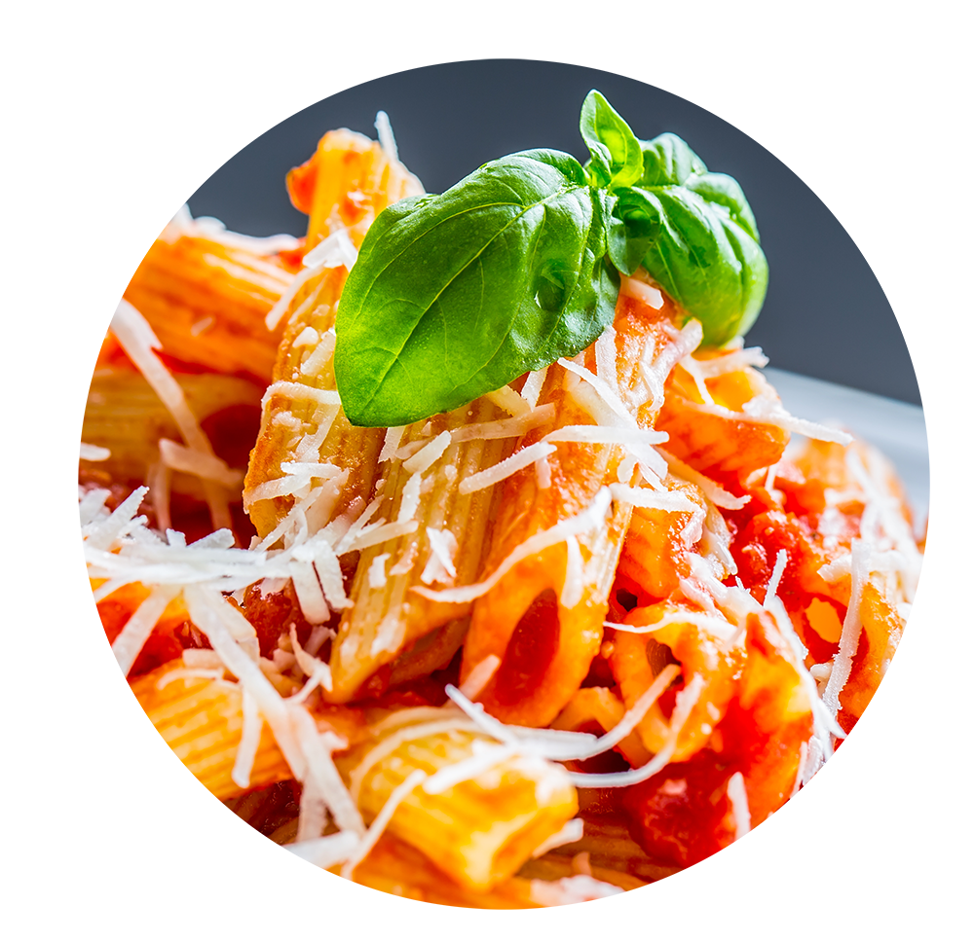
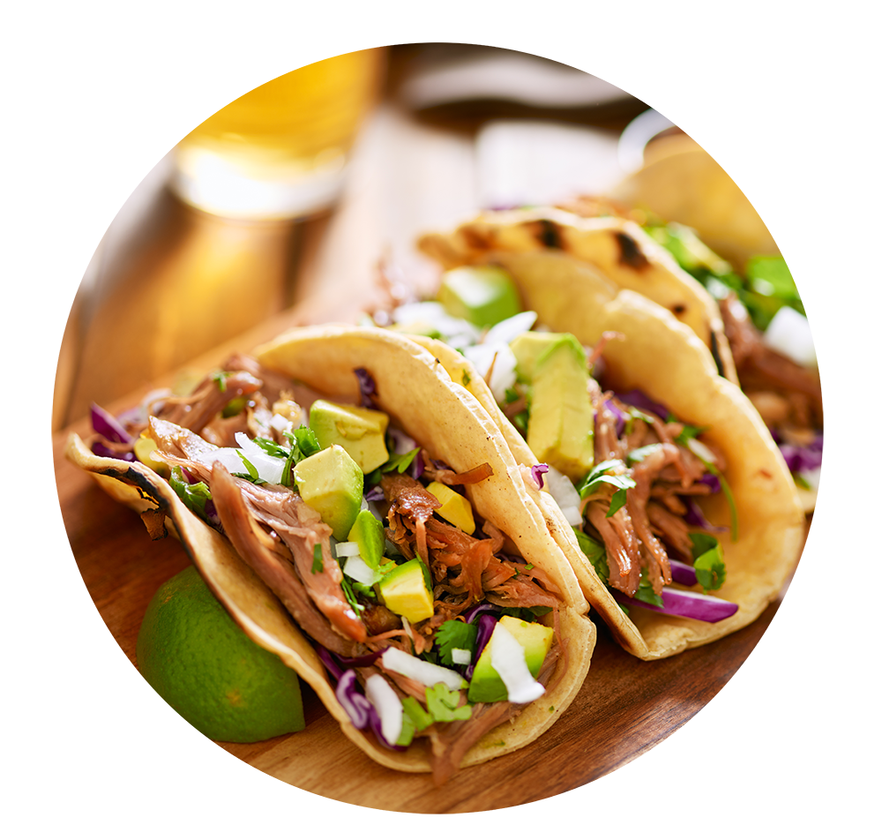
Group Activity: The Great Debate
Which do Americans prefer:
Italian or Mexican food?
Notes:
shutterstock_468051026
shutterstock_441287701

Slide 46

Group Activity: The Great Debate
Suggested Time: 20 minutes
With your group, develop a strategy for answering this question with as much confidence possible. Specifically, answer questions like:
Assumptions:
You are given 5 hours and a budget of $10 to accomplish this.
Your answer will be tested by randomly selecting 9 Americans who will each be asked the question—with 0 qualifiers.
You only have your team.
What data will you attempt to gather?
What relationships will you be looking for?
How will you ensure your answer is most likely “true”?

Slide 47
The Great Debate (Analyzed)

Slide 48
Step 1: Decompose the “Ask”

Slide 49
Step 1: Decompose the “Ask”
Which do Americans prefer:
Italian or Mexican food?
Notes:
shutterstock_468051026
shutterstock_441287701

Slide 50
Step 1: Decompose the “Ask”
Which do Americans prefer: Italian or Mexican food?
Who exactly is an American?
Are Americans just homeowners?
Do Americans just live in big cities?
Are Americans just millennials?

Slide 51
How can we get a representative sample of Americans?

Slide 52
Step 1: Decompose the “Ask”
Which do Americans prefer:
Italian or Mexican food?
Notes:
shutterstock_468051026
shutterstock_441287701

Slide 53
Step 1: Decompose the “Ask”
Which do Americans prefer: Italian or Mexican food?
How do we define “preference”?
Do people prefer the foods they eat most frequently?
Do people prefer the foods they wish they could eat if cost was not an issue?
How uniform is the preference? Is it regionalized? Is it different by demographic?

Slide 54
Inherently, preference is subjective. We are going to need to make it objective.

Slide 55
Step 1: Decompose the “Ask”
Which do Americans prefer:
Italian or Mexican food?
Notes:
shutterstock_468051026
shutterstock_441287701

Slide 56
Step 1: Decompose the “Ask”
Which do Americans prefer: Italian or Mexican food?
How do we categorize foods? Is pizza Italian? Is Taco Bell Mexican?
How do we categorize food? Does making pasta at home constitute Italian? Or are we just talking about restaurants?
Are we just talking about “best experiences”? Or are we including poorer renditions of these foods?

Slide 57
Italian and Mexican are broad categories we are pursuing. We will have to narrow the scope.

Slide 58
Step 2: Identify Data Sources

Slide 59
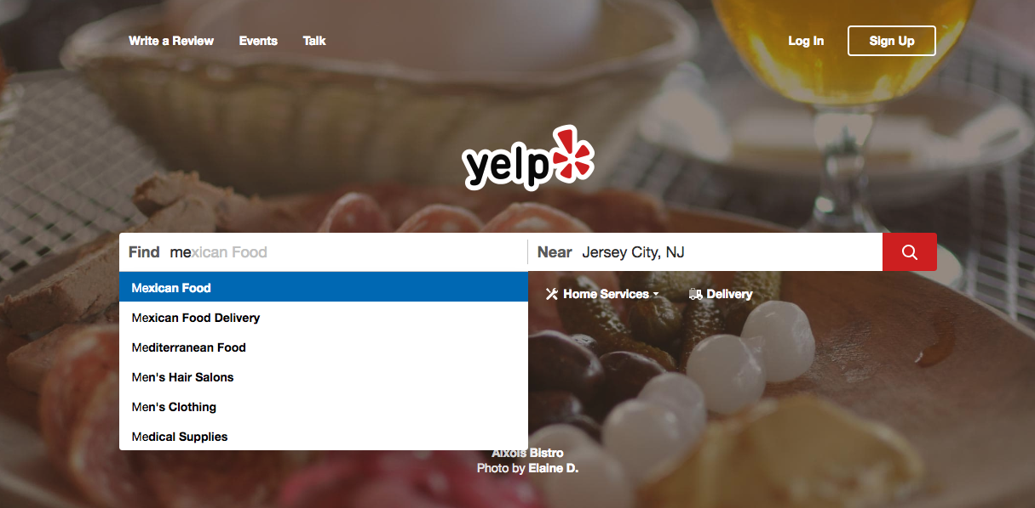
Step 2: Identify Data Sources
As everyday consumers, we are regularly getting a pulse of everyday American food preferences to inform our own decisions. Perhaps we can make use of the same approach.
www.yelp.com
Notes:
Screenshot from Yelp considered “low-risk”

Slide 60
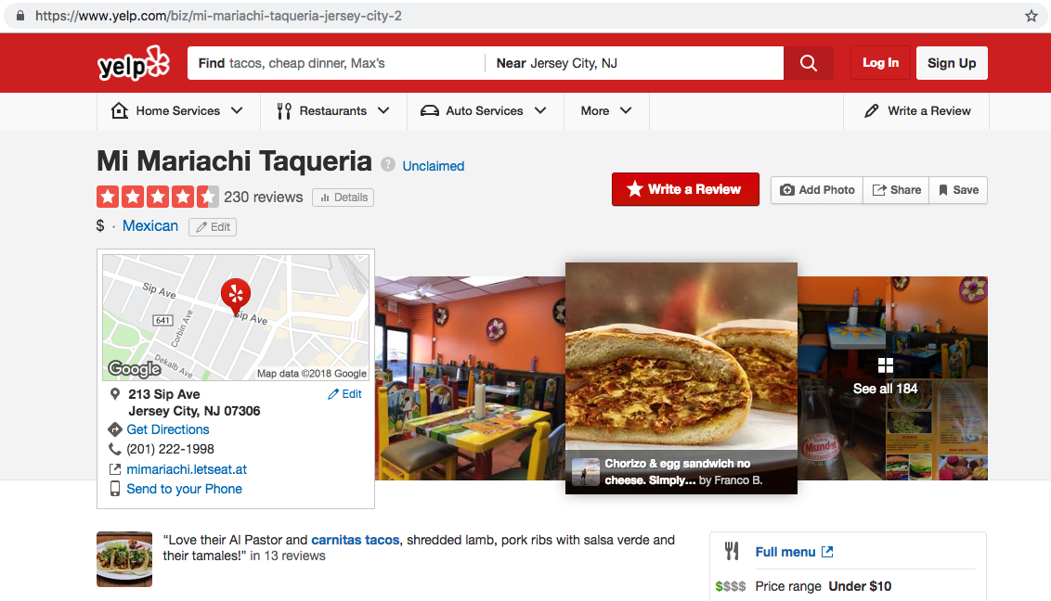
Step 2: Identify Data Sources
Web services like Yelp provide an almost encyclopedic amount of information about the eating preferences of Americans.
www.yelp.com
Notes:
Screenshot from Yelp considered “low-risk”

Slide 61









Step 2: Identify Data Sources
Why poll an audience when there already exist enormous databases of information about Americans’ food preferences—readily available online?
Notes:
Logos considered “low-risk”

Slide 62
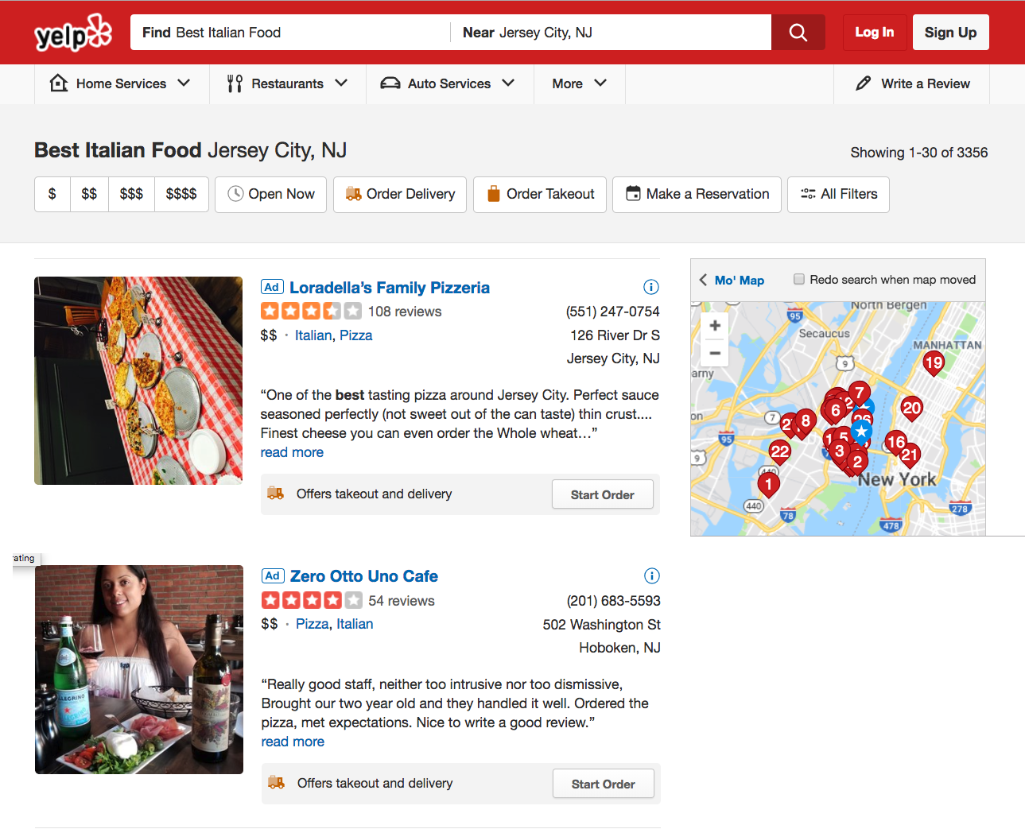

Step 2: Identify Data Sources
Food Type
Lots of Data!
Review Count
Locations
Rating
www.yelp.com
Notes:
Screenshot from yelp considered “low-risk”

Slide 63
Step 3: Define Strategy and Metrics

Slide 64
Step 3: Define Strategy and Metrics
Here we created a blueprint for what we’re targeting:
Americans:
Ideally, we need thousands of records from Americans in hundreds of different cities. (Large samples)
Preference:
Number of Yelp Reviews (More = Preference)
Average Aggregated Ratings (Higher = Preference)
Italian and Mexican Food:
Top 20 Italian and Mexican restaurants in every city

Slide 65
Step 3: Define Strategy and Metrics
Repeat this analysis for as many cities as possible.
New York, NY
Italian | Mexican
Restaurant | Restaurant
Restaurant | Restaurant
Restaurant | Restaurant
Restaurant | Restaurant
Restaurant | Restaurant
Tucson, AZ
Italian | Mexican
Restaurant | Restaurant
Restaurant | Restaurant
Restaurant | Restaurant
Restaurant | Restaurant
Restaurant | Restaurant
Washington, D.C.
Italian | Mexican
Restaurant | Restaurant
Restaurant | Restaurant
Restaurant | Restaurant
Restaurant | Restaurant
Restaurant | Restaurant
VS.
VS.
VS.
Omaha, NE
Italian | Mexican
Restaurant | Restaurant
Restaurant | Restaurant
Restaurant | Restaurant
Restaurant | Restaurant
Restaurant | Restaurant
San Diego, CA
Italian | Mexican
Restaurant | Restaurant
Restaurant | Restaurant
Restaurant | Restaurant
Restaurant | Restaurant
Restaurant | Restaurant
Atlanta, GA
Italian | Mexican
Restaurant | Restaurant
Restaurant | Restaurant
Restaurant | Restaurant
Restaurant | Restaurant
Restaurant | Restaurant
VS.
VS.
VS.

Slide 66
Step 4: Build Data Retrieval Plan

Slide 67
Step 4: Build Data Retrieval Plan
We could retrieve this data by brute force, but it would be:
Extremely time consuming
Skewed by our city familiarity
Labor intensive
Mexican
New York, NY
Mexican
Denver, CO
Mexican
Oklahoma City, OK
www.yelp.com
Notes:
Screenshot from Yelp considered “low-risk”

Slide 68
Step 4: Build Data Retrieval Plan
Basically, it would be nearly impossible.
Mexican
New York, NY
Mexican
Denver, CO
Mexican
Oklahoma City, OK
www.yelp.com
Notes:
Screenshot from Yelp considered “low-risk”

Slide 69
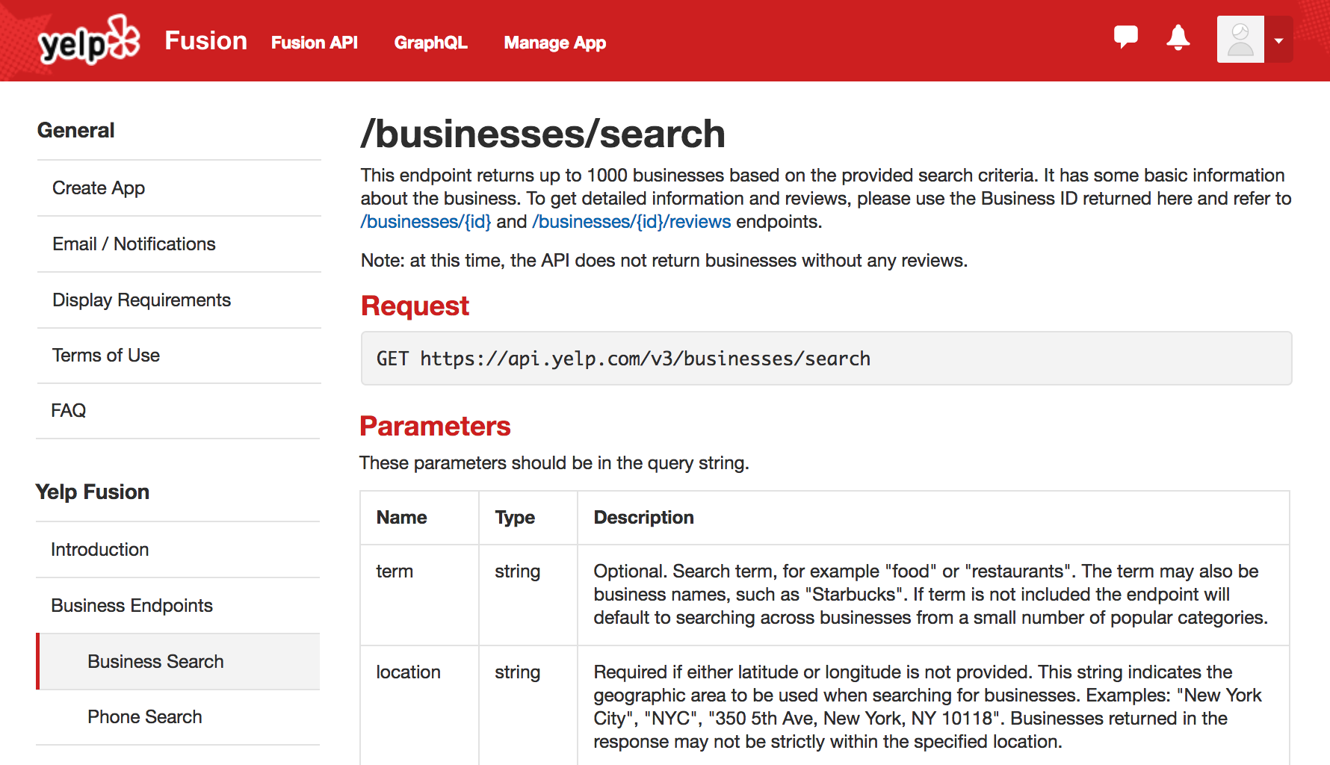
Thank You, Yelp!
Thankfully, we can take advantage of the Yelp Fusion API to programmatically run our queries. (#ThankGoodnessForProgramming)
www.yelp.com
Notes:
Screenshot from Yelp considered “low-risk”

Slide 70
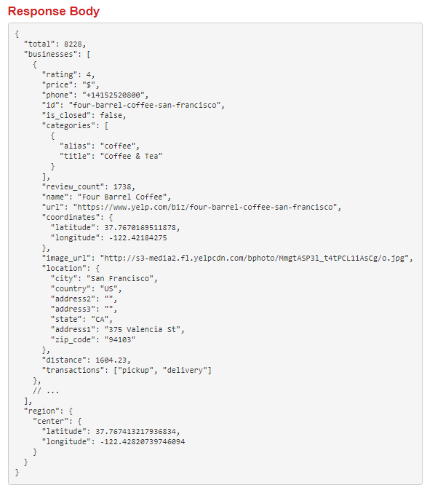

Thank You, Yelp!
www.yelp.com
Notes:
Screenshot from Yelp considered “low-risk”

Slide 71



Step 4: Build Data Retrieval Plan
We will build a Python script to randomly select over 700 zip codes from the U.S. Census, and then acquire review data from the top 20 Mexican and Italian restaurants for each zip code using the Yelp API.
11101
Italian | Mexican
Restaurant | Restaurant
Restaurant | Restaurant
Restaurant | Restaurant
Restaurant | Restaurant
Restaurant | Restaurant
07360
Italian | Mexican
Restaurant | Restaurant
Restaurant | Restaurant
Restaurant | Restaurant
Restaurant | Restaurant
Restaurant | Restaurant
20001
Italian | Mexican
Restaurant | Restaurant
Restaurant | Restaurant
Restaurant | Restaurant
Restaurant | Restaurant
Restaurant | Restaurant
68007
Italian | Mexican
Restaurant | Restaurant
Restaurant | Restaurant
Restaurant | Restaurant
Restaurant | Restaurant
Restaurant | Restaurant
22434
Italian | Mexican
Restaurant | Restaurant
Restaurant | Restaurant
Restaurant | Restaurant
Restaurant | Restaurant
Restaurant | Restaurant
30301
Italian | Mexican
Restaurant | Restaurant
Restaurant | Restaurant
Restaurant | Restaurant
Restaurant | Restaurant
Restaurant | Restaurant
www.yelp.com
Notes:
Screenshot from Yelp considered “low-risk”

Slide 72
Step 5: Retrieve the Data

Slide 73
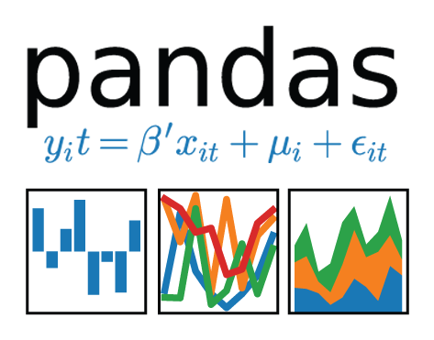
Pulling with Python
Randomly Select a Zip Code
Save the Output to a Data Frame
Create an API Request
Notes:
Screenshot from Yelp considered “low-risk”

Slide 74
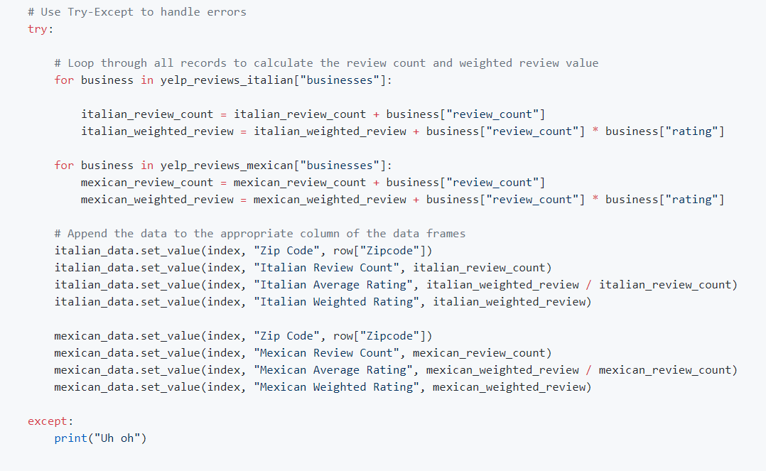
Pulling with Python
This funky code...

Slide 75
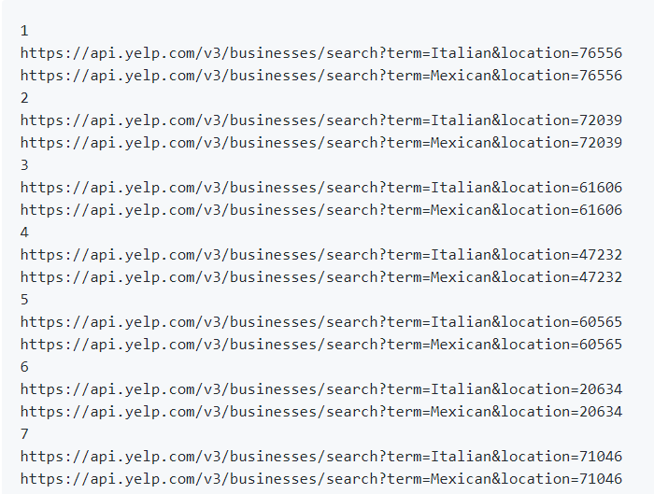
Pulling with Python
...will make all of these URLs.

Slide 76
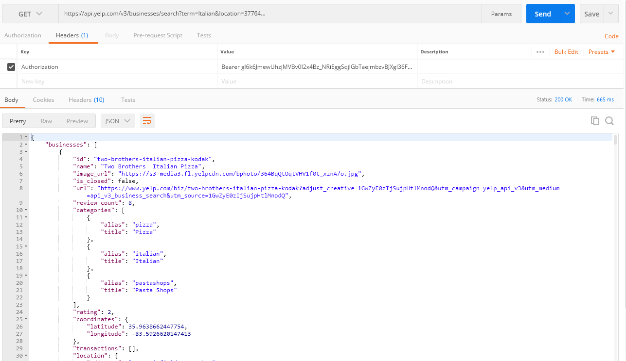
Pulling with Python
Each of these URLs holds a piece of our answer.

Slide 77
Step 6: Assemble and Clean the Data

Slide 78
Cleaning with Pandas
No data comes out intrinsically the way you want it to.
In our case, we needed multiple steps to aggregate the data along our channels of interest.
# Combine DataFrames into a single DataFrame combined_data = pd.merge(mexican_data, italian_data, on=”Zip Code”) combined_data.head( )
 | Zip Code | Mexican Review Count | Mexican Average Rating | Mexican Weighted Rating | Italian Review Count | Italian Average Rating | Italian Weighted Rating
0 | 76556 | 97 | 4.1134 | 399 | 63 | 3.78571 | 238.5
1 | 72039 | 256 | 4.11133 | 1052.2 | 266 | 3.81955 | 1016
2 | 61606 | 378 | 3.64286 | 1377 | 66 | 3.2197 | 212.5
3 | 47232 | 222 | 4.16892 | 925.5 | 420 | 3.77857 | 1587
4 | 60565 | 2842 | 3.94053 | 11199 | 2829 | 3.92824 | 11113

Slide 79
Step 7: Analyze for Trends

Slide 80
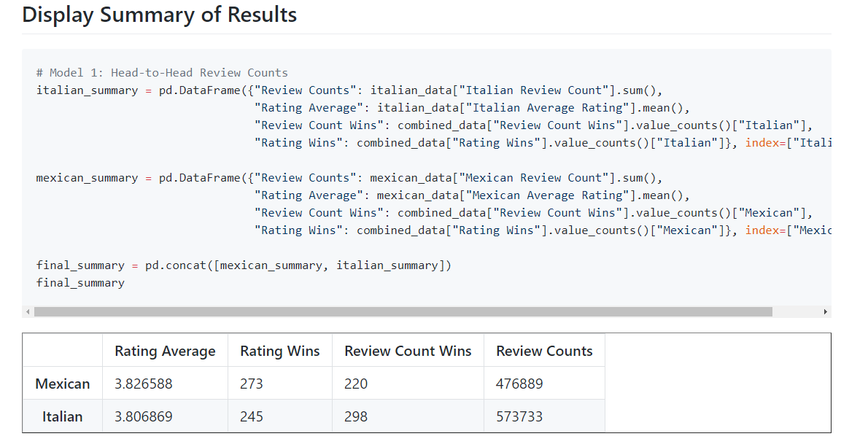
Analyze for Trends (Table)
It’s Close:

Slide 81
Analyze for Trends (Ratings)
Yelpers rate Italian and Mexican relatively equally.
4.0
3.5
3.0
2.5
2.0
1.5
1.0
0.5
0.0 | Mexican | Italian
Yelp Ratings by Food Variety
=
Average Rating
Food Variety
www.yelp.com
Notes:
shutterstock_468051026
shutterstock_441287701

Slide 82
Analyze for Trends (Ratings)
Yelpers seem to significantly review more Italian restaurants.
Yelp Ratings by Food Variety
600000
500000
400000
300000
200000
100000
0.0 | Mexican | Italian
Review Counts
Food Variety
www.yelp.com
Notes:
Yelp logo considered “low-risk”

Slide 83
Analyze for Trends (Winner Take All)
Just for kicks, let’s throw in an analysis that aggregates the data from all cities using a winner-take-all approach.
It’s sort of a wash.
 | # of Cities with Preference by Food Variety According to Rating
300
250
200
150
100
50
0 | Mexican | Italian
 | Food Variety
 | # of Cities with Preference by Food Variety According to Review Counts
300
250
200
150
100
50
0 | Mexican | Italian
 | Food Variety
# of Cities
# of Cities
www.yelp.com

Slide 84
Analyze for Trends (Statistical Analysis)
Because of how close the numbers appear, we utilized a Student’s t-test to quickly assess if the perceived differences are not statistically significant but could be considered substantial.
Metric | Italian | Mexican | p-Value (t-test)
Average Rating | 3.806 | 3.826 | 0.284
Review Counts | 573k | 476k | 0.057
The difference in review count is not statistically significant.

Slide 85
Step 8: Acknowledge Limitations

Slide 86
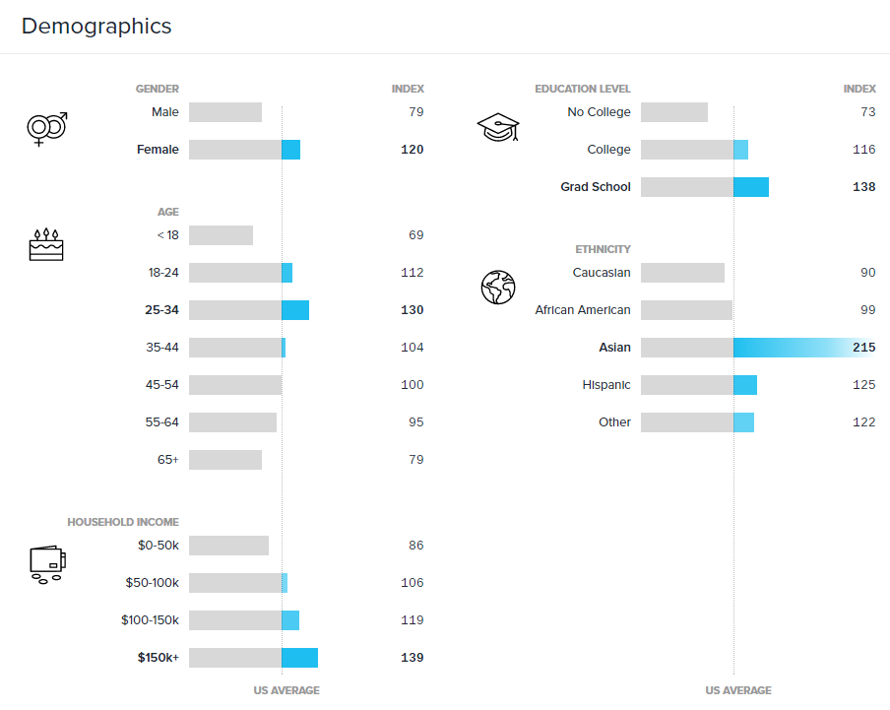
Limitations of Analysis
Yelp demographics may not match the American demographic.
www.yelp.com
Notes:
Yelp logo considered “low-risk”

Slide 87

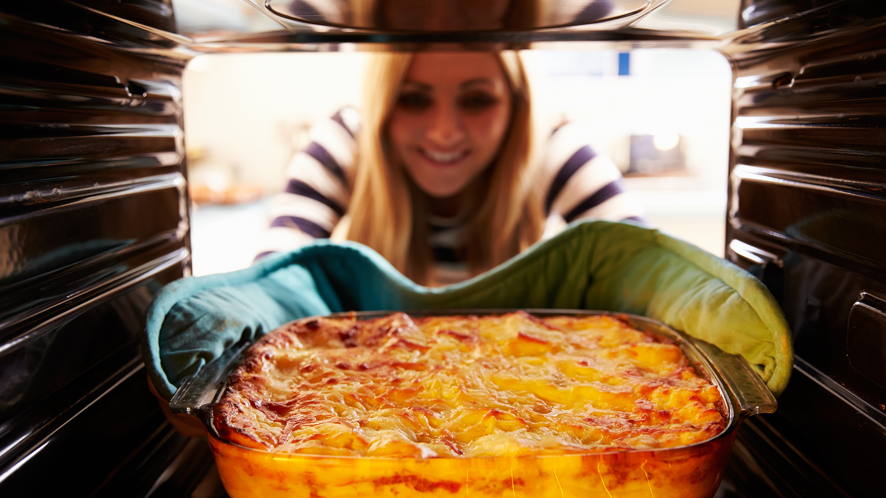
Limitations of Analysis
Restaurant experiences do not equate to home-cooked meals.
Notes:
shutterstock_78016495
shutterstock_234673435.

Slide 88

Limitations of Analysis
Fine-dining effect?
Notes:
shutterstock_244454620

Slide 89
Step 9: Make the Call

Slide 90
Making the Call
The “Proper” Conclusion:
Based on our analysis, it’s clear that Americans’ preferences for Italian and Mexican food are similar in nature. As a whole, Americans rate Mexican and Italian restaurants at non-statistically similar scores (avg. score: 3.8, p-value: 0.285). Although there are more reviews for Italian restaurants, we have shown that the difference is statistically significant (+96k, p-value: 0.057).
This may indicate there is an increased interest in visiting Italian restaurants at an experiential level. Or it may merely suggest that Yelp users enjoy writing reviews of Italian restaurants more than Mexican restaurants.
Notes:
shutterstock_441287701

Slide 91
Making the Call
The “Let’s Be Real” Conclusion: Italian (but it’s going to be close).
Notes:
shutterstock_441287701

Slide 92
An Analytics Paradigm

Slide 93
Analytics Paradigm
Regardless of type or industry, this paradigm provides a repeatable pathway for effective data problem solving.
Vestibulum congue tempus
Decompose the Ask
Identify Data Sources
Define Strategy and Metrics
Assemble and Clean
Retrieve the Data
Build Data Retrieval Plan
Analyze for Trends
Acknowledge Limitations
Make the Call or Tell the Story

Slide 94
Group Activity: Predicting Gentrification
Using the Analytics Paradigm as a framework, outline a strategy by which you would identify which neighborhoods in our city are seeing signs of gentrification.
13 minutes

Slide 95

Group Activity: Predicting Gentrification
Suggested Time: 13 minutes
Specifically, how would you answer these questions:
Pay special attention to details like:
What observable signs can we detect to suggest gentrification is happening?
What means can we use to determine how long the trend has been happening?
What proxies might we use to identify gentrification in non-obvious ways?
How might you create a visualization of this data to best “tell the story”?
What data will you use to build your model?
How will you retrieve the data?
What does your final “story” look like?

Slide 97
Homework: Kickstart My Chart

Slide 98
Prepare for Next Class
By Next Class:
Make certain that you have Microsoft Excel installed.
Make certain that you have Slack installed and are actively looking at it.
Figure out where the Git repository for our class is.
Figure out where class videos will be posted.

Slide 99
Questions?

